Slide 1
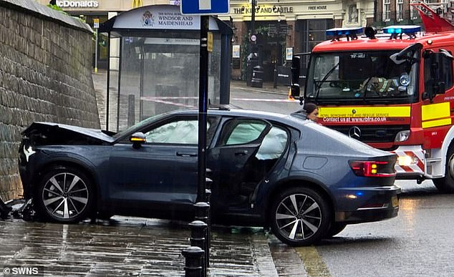
Traffic Accident Analysis in the UK: A Statistical Approach to Rural vs. Urban Casualties
Team 4: Izhar Carrera Michelle Abell Jacobo Michelle Rodriguez Sean Williams
Data Source (91.69 MB) : Road Accident Casualties Dataset (Kaggle)
https://www.kaggle.com/datasets/nezukokamaado/road-accident-casualties-dataset?select=accident+data.csv
Objective: Analyzing the impact of road conditions, weather, and area type on traffic accident casualties using statistical modeling and SAP Analytics Cloud.
Notes:
Izhar

Slide 2
Data and Objective
Data Source: Kaggle: Road Accident Casualties Dataset
Objective:
Analyze the differences between rural and urban traffic accidents in the UK.
Investigate how weather, area type, and location impact accident rates.
Utilize statistical modeling and SAP Analytics Cloud to identify patterns.
Provide insights for public safety measures and traffic management strategies.
Notes:
Izhar

Slide 3

SAP Analytics Cloud SAC
What is SAP Analytics Cloud (SAC)?
SAP Analytics Cloud is a platform for data visualization, predictive analytics, and business intelligence. It enables users to analyze large datasets, generate insights, and make data-driven decisions.
How We Used SAP Analytics Cloud
Processed and cleaned accident data for accuracy
Mapped accident locations across the UK
Identified trends in accident frequency and severity
Created visualizations to explore key correlations
Why SAP Analytics Cloud?
Cloud-based platform for real-time data analysis
Advanced analytics and predictive modeling capabilities
Integration with various data sources for deeper insights
Notes:
Izhar

Slide 4
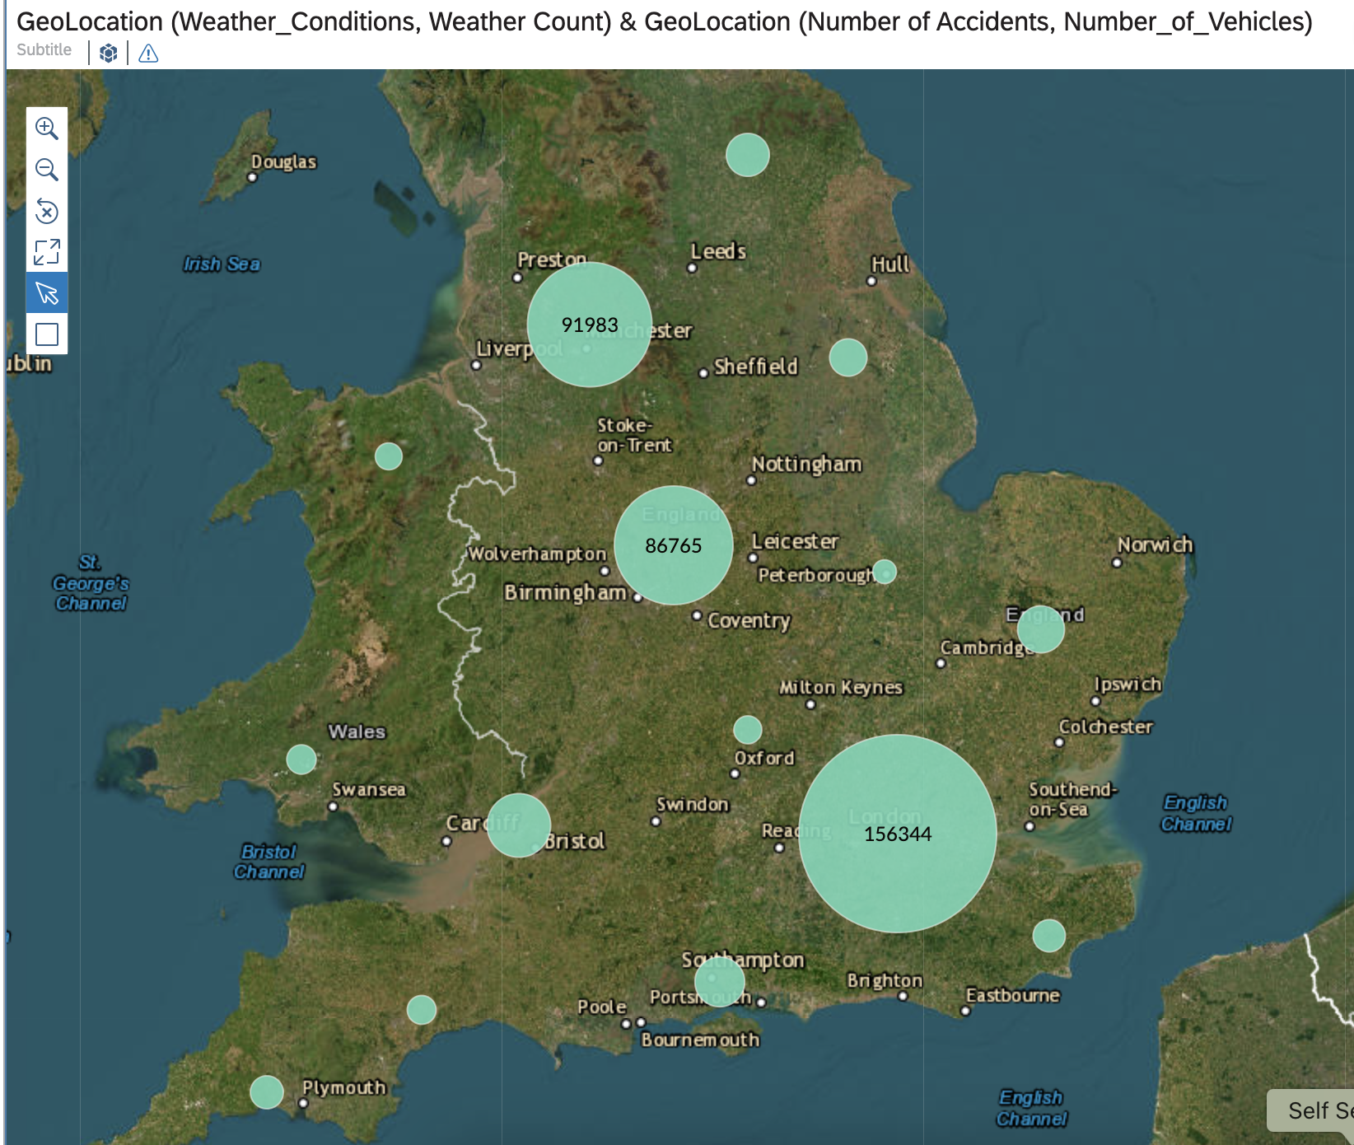
Geographic Distribution of Traffic Accidents
Description: This map visualizes the number of traffic accidents across different regions in the UK. Larger circles indicate areas with a higher concentration of accidents. By identifying accident hotspots, we can assess whether urban areas experience more incidents than rural areas, helping to shape data-driven traffic safety strategies.
Notes:
Michelle R.

Slide 5
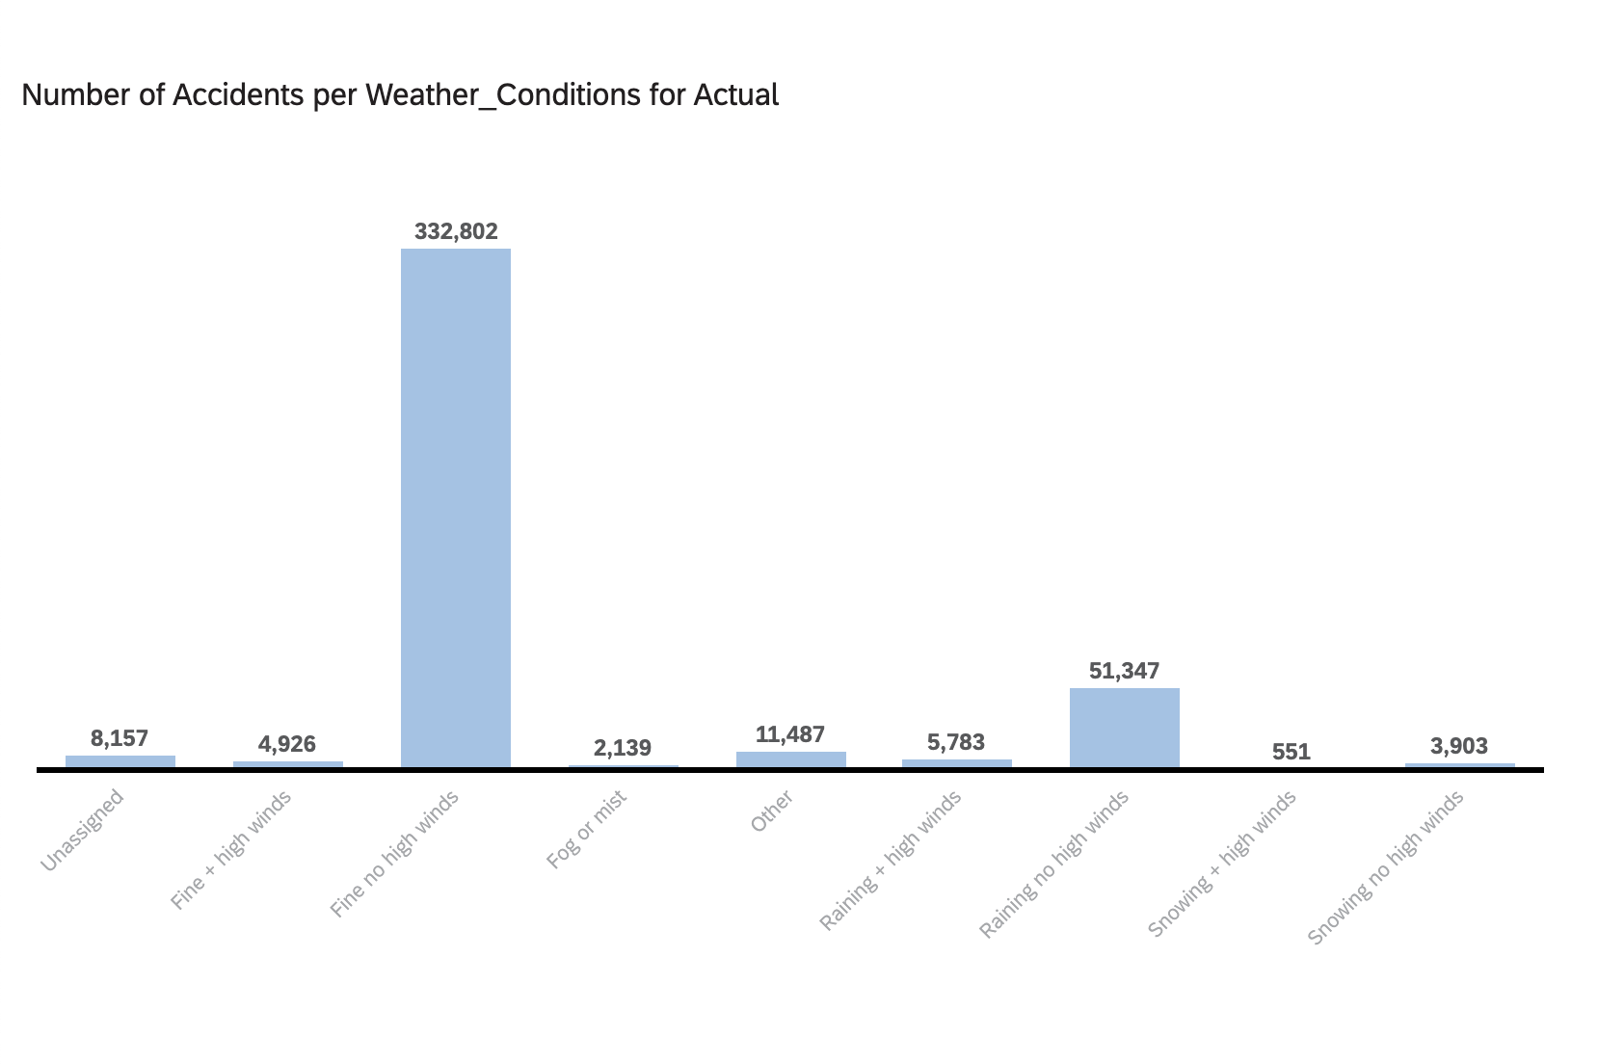
Weather Conditions and Traffic Accidents
Key Insights
Most accidents occur in fine weather with no high winds (332,802), suggesting normal conditions do not prevent crashes.
Rain without high winds (51,347) is the next highest, showing wet roads may increase accident risk.
There are fewer accidents that take place in fog, snow, and high winds, possibly due to reduced driving conditions.
Takeaway
Weather plays a role, but human factors may contribute more to accident frequency.
Notes:
Michelle R

Slide 6
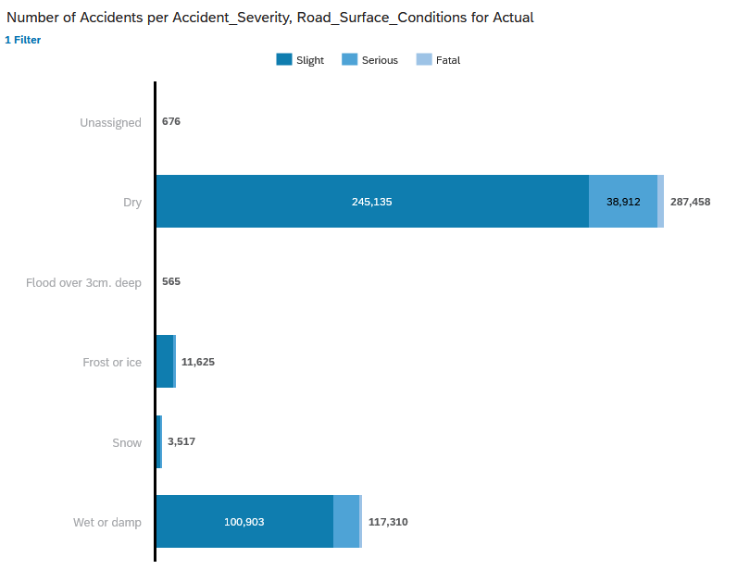
Accident Severity and Road Conditions
This chart shows how accident severity varies under different road conditions. While most accidents happen in dry conditions, the severity of accidents in wet conditions could be more dangerous.
Notes:
Michelle R

Slide 7
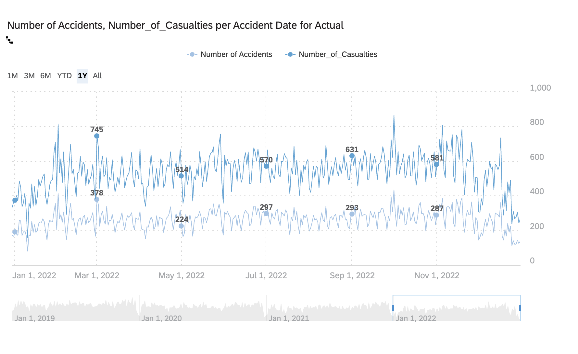
Trends in Accidents and Casualties Over Time
Description:
This chart tracks the daily number of accidents and casualties over time.
Peaks in accident rates suggest external influences such as weather, congestion, or seasonal changes.
Identifying these trends helps determine if certain conditions lead to higher accident rates in rural vs. urban areas.
Notes:
Michelle R

Slide 8
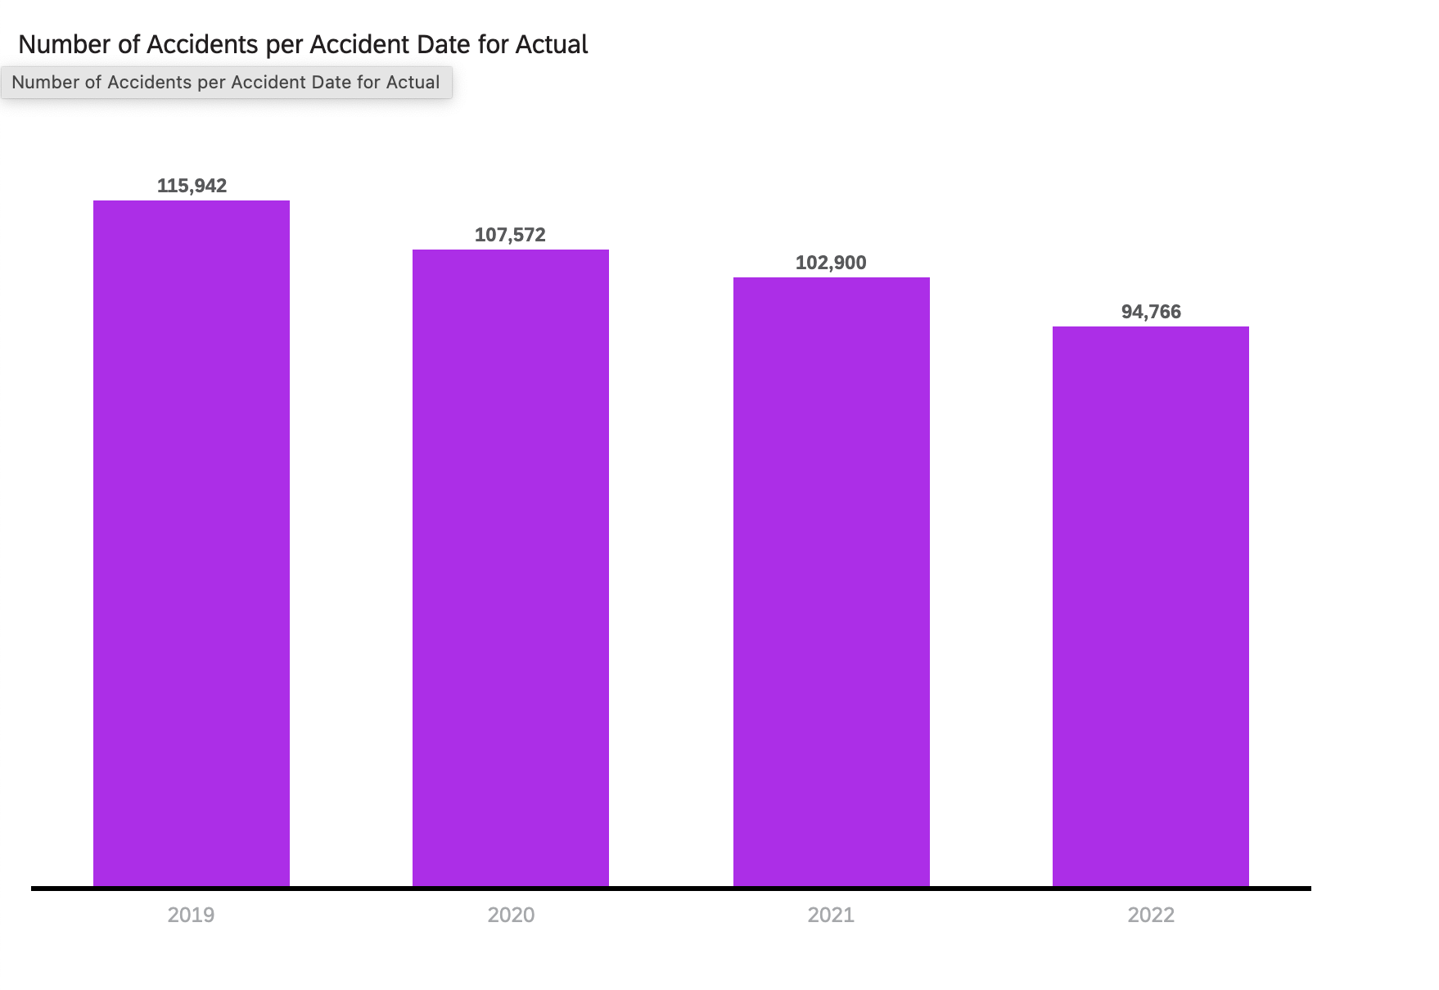
Annual Decline in Accidents
Description:
Accidents have steadily declined from 115,942 in 2019 to 94,766 in 2022.
Possible causes include improved road safety, pandemic-related travel changes, and traffic shifts between rural and urban areas.
Takeaway:
Further breakdown needed to determine if accident reductions were more significant in urban or rural regions.
Notes:
Sean W

Slide 9
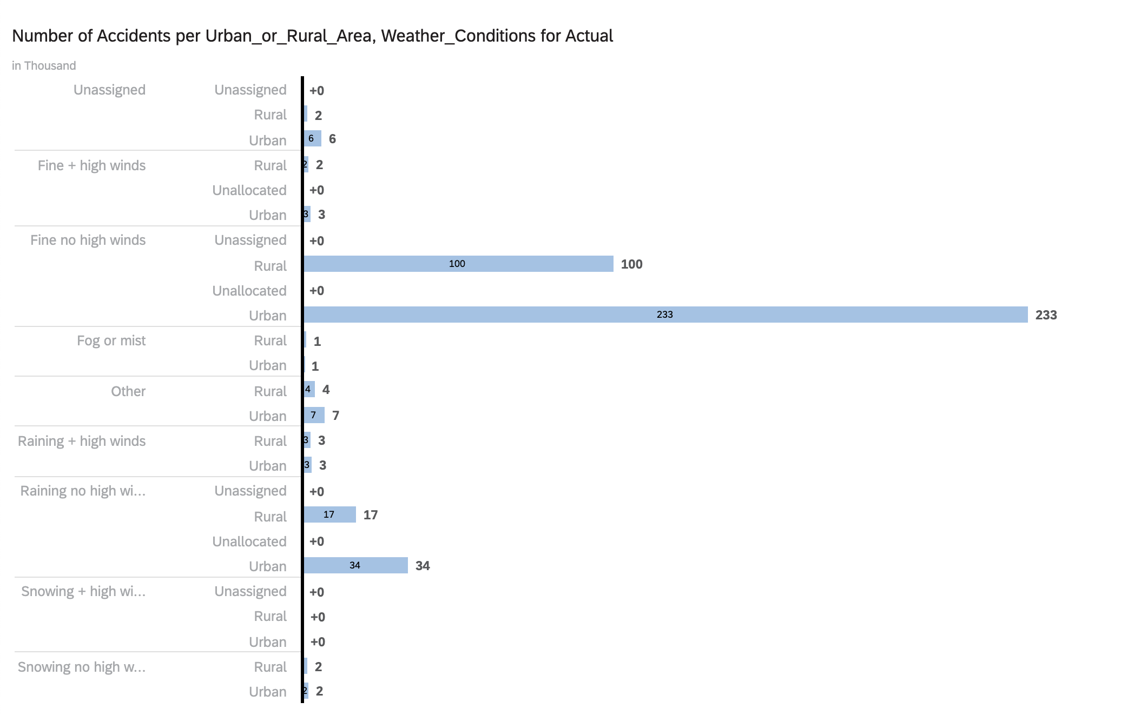
Weather Impact on Urban vs. Rural Accidents
Key Insights:
Most accidents happen in fine weather, showing driver behavior matters more than weather.
Rain without high winds causes more urban accidents (34k) but is still a risk in rural areas (17k).
Fog, snow, and extreme weather lead to fewer accidents, likely due to reduced driving.
Takeaway:
Rural roads may have fewer accidents but higher risks in bad weather due to poor infrastructure and emergency response delays.
Notes:
Sean W

Slide 10
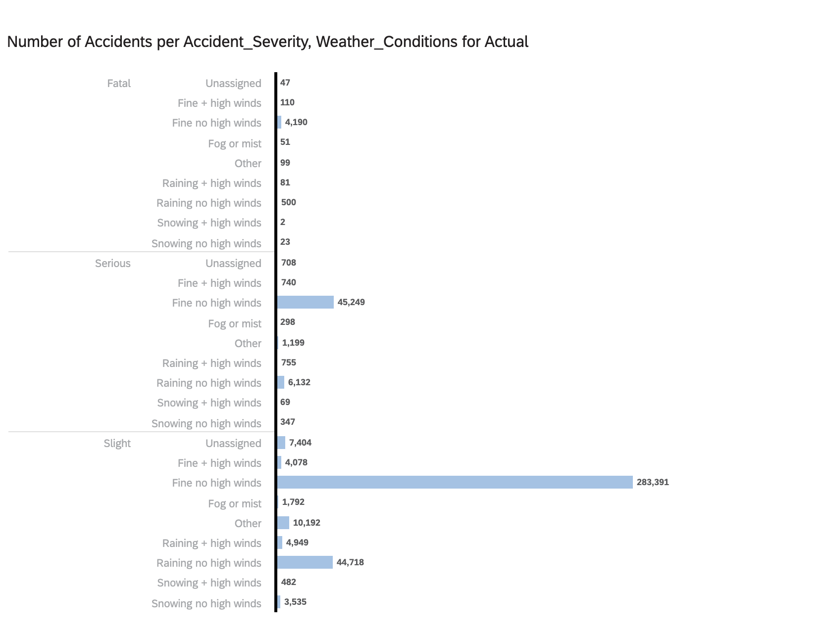
Accident Severity by Weather Conditions
Description:
Slight accidents are most common in all weather conditions, especially in fine weather (283,391 slight accidents).
Serious and fatal accidents occur more often in wet and snowy conditions, posing greater risks for rural areas.
Takeaway:
While urban areas experience more total accidents, rural roads may have higher fatality rates due to speed limits, poor lighting, and emergency response times.
Notes:
Sean W

Slide 11
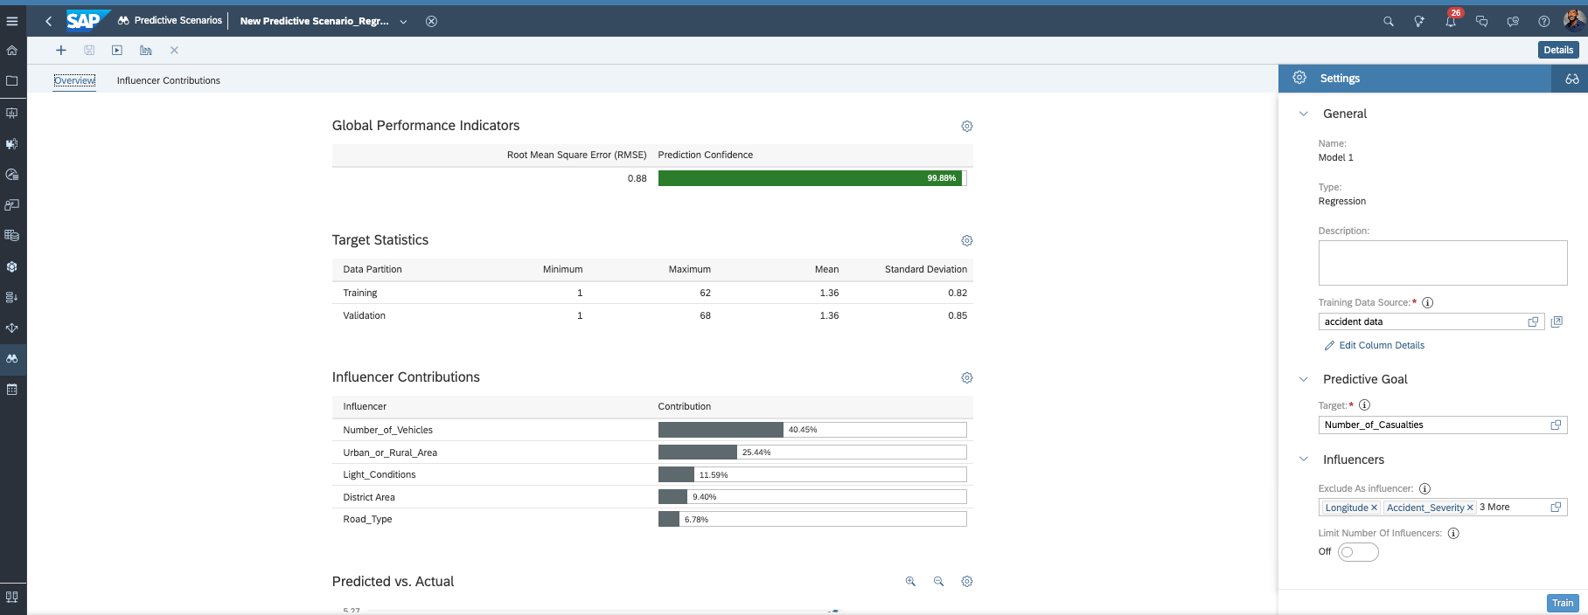
Using Regression to Understand Rural vs. Urban Accident Patterns
Description:
Regression analysis helps us quantify the relationship between accident severity and key factors like weather, road type, and location (rural vs. urban).
It allows us to determine which factors have the strongest influence on accident severity and casualty rates.
Why Regression?
Identifies key predictors of accident severity and casualty numbers.
Helps validate trends seen in descriptive statistics.
Provides a data-driven approach to shaping road safety policies.
Notes:
Michelle AJ

Slide 12
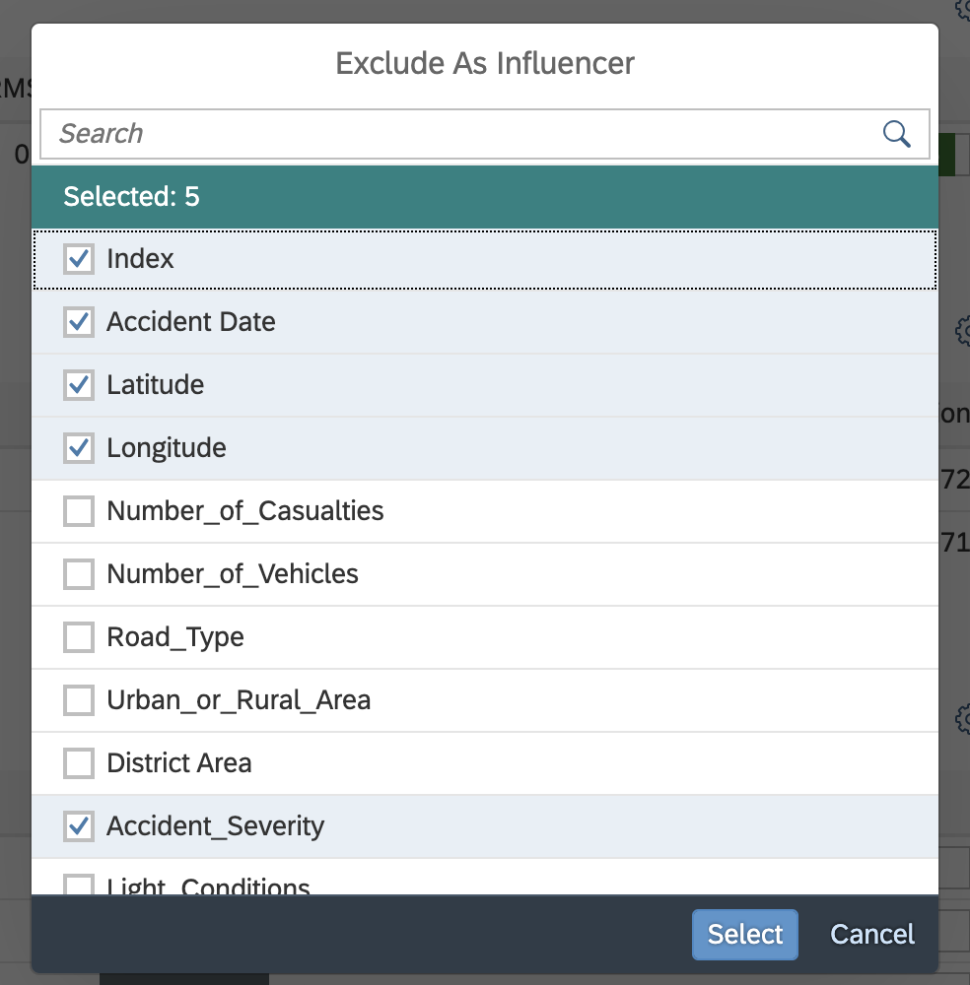
Filtering Key Influencers for Accurate Regression Analysis
Description:
To refine our model, we exclude variables that don’t contribute to accidents (e.g., Index, Latitude, Longitude).
This ensures we focus on relevant factors like number of vehicles, road type, and urban vs. rural classification.
Takeaway:
The regression model is built on the most influential factors affecting accident severity.
Notes:
Michelle AJ

Slide 13
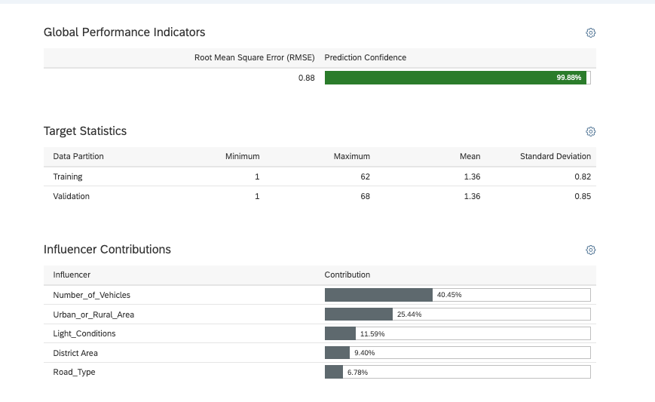
Model Accuracy and Key Predictors of Accident Severity
Description:
The regression model shows a Root Mean Square Error (RMSE) of 0.88 with 99.88% prediction confidence, indicating a strong and reliable model.
The most significant predictor of the number of vehicles involved in an accident is Number of Vehicles (40.45%), followed by Urban or Rural Area (25.44%).
Other relevant factors include Light Conditions, District Area, and Road Type.
Takeaway:
Urban or rural location has a notable influence on the number of vehicles involved, suggesting different accident dynamics between dense city traffic and open rural roads.
Notes:
Michelle AJ

Slide 14
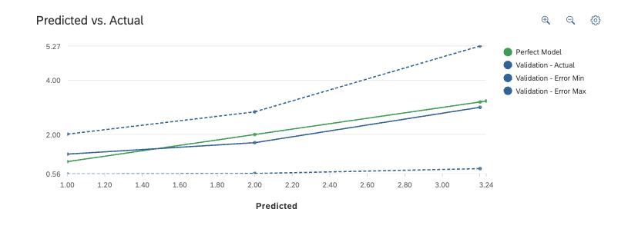
How Well Does Our Model Predict Accident Severity?
Description:
The model closely follows actual accident severity trends.
Error margins remain consistent, meaning the model is reliable for evaluating accident risk factors.
Takeaway:
The model can be used to understand future accident severity trends based on rural vs. urban characteristics.

Slide 15
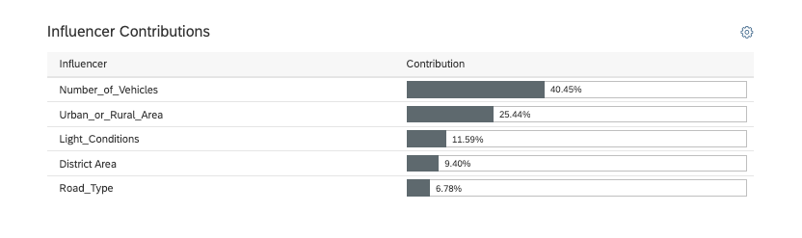
How Location (District Area) Affects Accident Severity
Description:
Some districts have greater accident severities than others.
Rural areas may have higher severity per accident, while urban areas may have more frequent but lower-severity accidents.
Takeaway:
District-based safety interventions could help reduce severe accidents in rural regions.

Slide 16
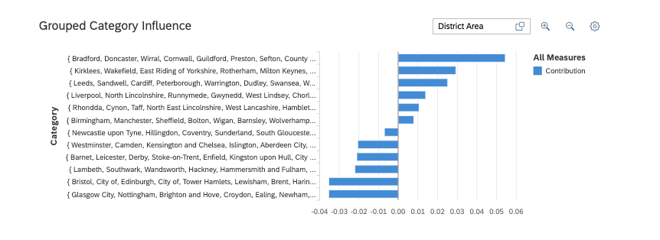
Grouped Category Influence on Accidents
Description:
The grouped category analysis shows which regions are more prone to severe accidents.
Urban areas contribute more frequent accidents, while rural areas show a trend of higher severity.
Takeaway:
The rural-urban divide in accident severity may require different safety strategies for each area type.

Slide 17
SAP Analytics Cloud: Regression
SAP Link : https://higher-education.us10.sapanalytics.cloud/sap/fpa/ui/app.html#/home
Notes:
Michelle AJ

Slide 18
Understanding Rural vs. Urban Traffic Accidents
What We Found:
Most accidents occur in fine weather, suggesting driver behavior is a major factor.
Rain increases severe accident risk, with urban areas having more crashes but rural roads experiencing higher severity.
Serious and fatal accidents are more common in rural areas, likely due to road conditions and emergency response times.
Regression analysis confirmed that number of vehicles, road type, and light conditions are key predictors of accident severity.
Why This Matters:
Urban areas need congestion management and accident prevention strategies.
Rural areas require better emergency response and road infrastructure improvements.
A data-driven approach can help shape targeted traffic safety policies.
Notes:
Izhar

Slide 19
Improving Road Safety Based on Data Insights
For Urban Areas:
Implement traffic control measures to reduce congestion-related crashes.
Improve road design for wet-weather driving.
For Rural Areas:
Enhance emergency response times and road infrastructure.
Increase lighting and signage for hazardous conditions.
Next Steps:
Expand predictive modeling to include driver behavior and road structure data.
Develop targeted policy recommendations for improving road safety.
Conduct further research to analyze long-term trends and accident prevention strategies.
Notes:
Izhar

